Slide 1
Analysis of Uber & Lyft Data
The Boston Lagers Group
Aaron Schwartzman, Benji Hawkins, David Seger & Rachidi Ndongala

Slide 2
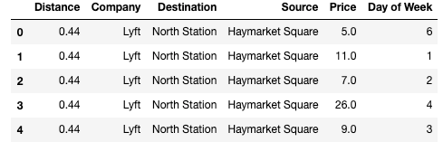
About the Data
The dataset used is entitled, “Uber & Lyft Cab prices” and was published on Kaggle by the user RaviMunde.
The dataset’s creators collected real-time data for Uber and Lyft operations in Boston, MA between November 2018 and December 2018.
Notes:
Aaron

Slide 3
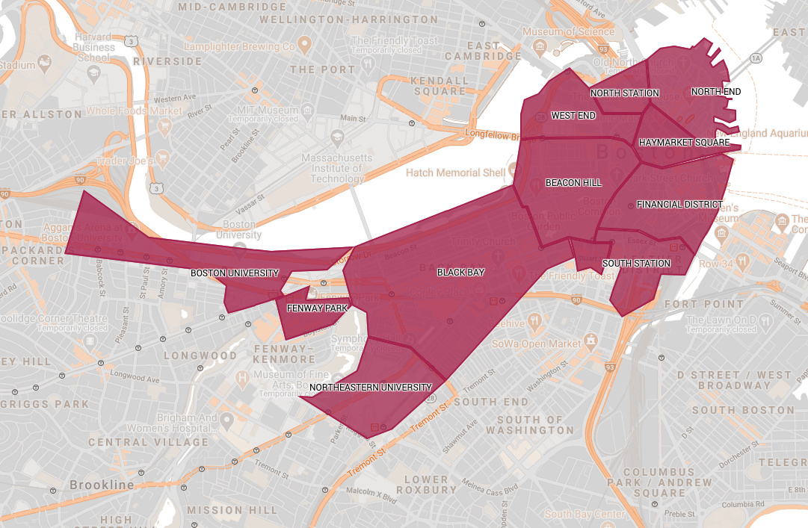
Map of Boston
The small area south of Beacon Hill is the Theatre District.
Notes:
Benji

Slide 4
Key Questions
What conclusions can we draw from how Bostonians use ride-sharing services?
How do ride distance and price compare amongst the various ride sources and destinations?
How much do rides typically cost?
How is Uber and Lyft demand affected by the day of week.
How similar are the operations of Uber and Lyft in Boston?
Which service is better for consumers from a financial perspective?
Notes:
Benji

Slide 5
Data Cleaning Procedure
Importation of a ride-sharing data set published by Kaggle user RaviMunde.
Use of the DatetimePy library to convert the 13-digit UNIX timestamp in order to determine the day of the week on which each data point was recovered.
Removal of extraneous columns not significant to the analysis.
Use of the DropNa function to remove about 60,000 columns missing essential data values.
Exportation of the cleaned data file for use in the analysis portion.
Notes:
Benji

Slide 6
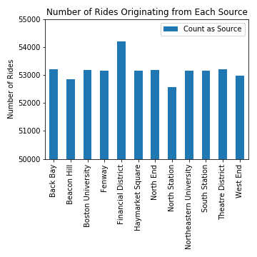
Bostonian Ride-Sharing Habits
From the analysis, the most popular ride source was found to be the Financial District, comprising 8.5% of all ride requests.
This is understandable, as many white-collar workers may elect to use ride-sharing services to travel home from their place of employment.
The least popular ride source is North Station.
Further research revealed that North Station is itself a public transit station, suggesting that Bostonians may elect to use public transit when departing this area.
It is important to note that the y-axis scale in this graph runs from 50,000 rides requested to 55,000 rides requested.
Notes:
Benji

Slide 7
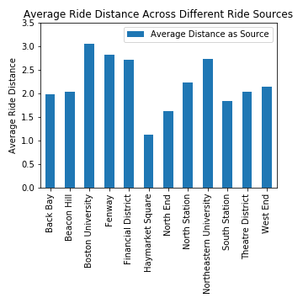
Average Distance By Location
The zones from which the longest rides originate include Boston University, Fenway, Northeastern University, and the Financial District.
One explanation for this observation is the fact that Boston University, Fenway, and Northeastern are located on the Western edge of the sample area, while the Financial District is located on the Eastern edge. Thus, frequent travel between these two regions (e.g. college students working internships in the Financial District) could inflate the average ride distances.
A related visualization showing Average Ride Price by Location exhibited similar trends. However, the pricing disparity between locations appeared less significant than the disparities in distance.
Notes:
Benji

Slide 8
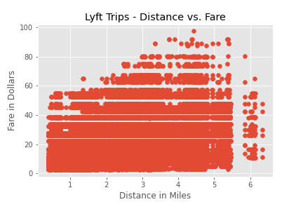
Lyft Distance vs. Fare
Notes:
David

Slide 9
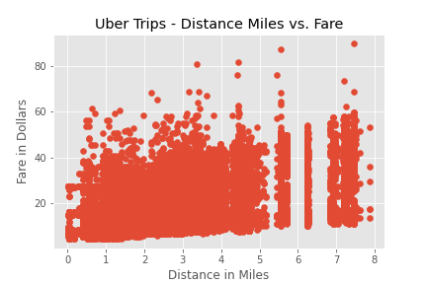
Uber Distance vs. Fare
Notes:
David

Slide 10
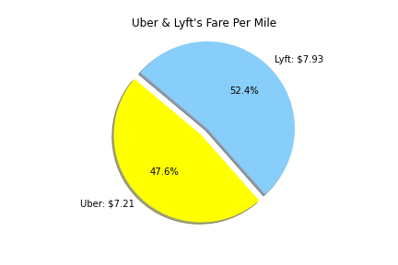
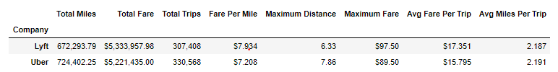
Uber Versus Lyft Average Fare/Mile
Lyft average fare price is $7.93 per mile
Uber average fare price is $7.21 per mile
Notes:
Aaron

Slide 11
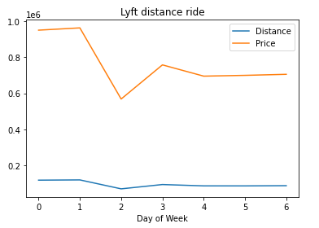
Uber vs lyft grouping by price and day of the week
By going through the data and trying to pull the trends between the price ride and the day of the week, we found that most of the people used the ride share on Wednesday, Thursday, Friday, Saturday and Sunday. The ride was not busy on Tuesday.
Talking about the price, we all know Uber as the premier and largest ride share in the worldwide and going through the data, we found out that Lyft price was slighting higher than Uber’s price. And that is the reason why most of the travelers choose Uber in the long distances and Lyft in the short distance.
Based on the analysis we did on our data; the plot bar was created for the Uber distance ride and the plot line was also created for the Lyft distance ride to show the sum of the distance and price on each day of the week.

Slide 12
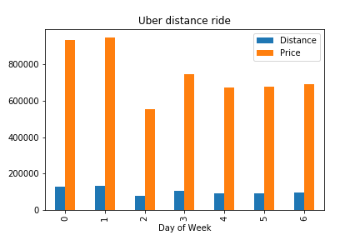
Uber distance ride each day of the week
Notes:
Rachidi

Slide 13
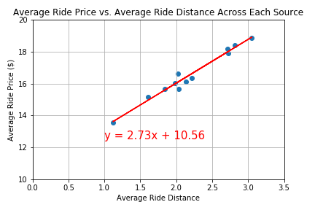
R = 0.99
Each point on the scatter plot represents one of the 12 locations and its position is determined by the average ride price and average ride distance for rides originating at the location.
The Pearson coefficient for this analysis was calculated to be 0.99, suggesting a very strong correlation between ride price and ride distance across the different sources.
Notes:
Benji

Slide 14
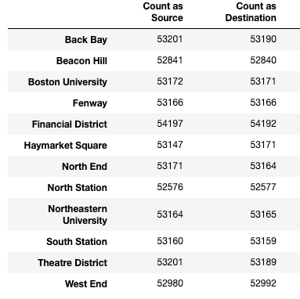
Dataset Considerations
There are some concerns as to the validity of the data.
Given the number of data points collected (over 600,000), one would expect that there would be greater variance among values such as the number of times that a location serves as a ride’s source or destination.
Given the dataset provided, another key factor to consider is surge pricing.
In looking through the dataset, it appears that surge pricing information was not present for Uber data. This may have affected any comparisons made between Uber and Lyft.
Notes:
Aaron

Slide 15
Future Directions
One area that we would have liked to research would be the demographics of Uber and Lyft users.
For example, looking at descriptors such as gender, race, socioeconomic status, and educational attainment.
It would be interesting to compare the conclusions found in our analysis to trends in the use of other forms of public transportation, such as the Massachusetts Bay railway and bus systems.
Notes:
Aaron

Slide 16
Questions?

